Slide 1

Exercise Name
Tabletop Exercise
Date of Exercise

Slide 2
Welcome and Overview

Slide 3
Exercise Overview
Exercise Scope
  This exercise is a table-top exercise, planned for X hours at LOCATION. Exercise play is limited to roundtable discussion.

Slide 4
Exercise Objective 1
EXAMPLE: Review emergency procedures and the roles and responsibilities of the Emergency Management Team in response to severe weather, in accordance with the Higher Education Center at McAllen Emergency Action Plan.

Slide 5
Exercise Objective 2
EXAMPLE: Determine the mechanism for coordinating emergency public information and warning in response to severe weather, in accordance with the Higher Education Center at McAllen Emergency Action Plan.

Slide 6
Exercise Objective 3
EXAMPLE: Define the process and timeframe for recovery and establish recovery priorities for damage produced by severe weather, in accordance with the draft Higher Education Center at McAllen Continuity Plan.

Slide 7
Participant Roles & Responsibilities
Players: Respond to situation presented based on current plans, policies, and procedures
Facilitators: Provide situation updates and moderate discussions

Slide 8
Exercise Structure
Facilitated discussion-based exercise.
Players will participate in X modules
  Module 1: Name
  Module 2: Name
  Module 3: Name

Slide 9
Exercise Guidelines
This is an open, low-stress, no-fault environment. Varying viewpoints, even disagreements, are expected
Base your responses on the current plans and capabilities of your organization
Decisions are not precedent setting; consider different approaches and suggest improvements
Issue identification is not as valuable as suggestions and recommended actions that could improve response and recovery efforts; problem-solving efforts should be the focus

Slide 10
Assumptions and Artificialities
The exercise is conducted in a no-fault learning environment wherein capabilities, plans, systems, and processes will be evaluated
The exercise scenario is plausible, and events occur as they are presented
All players receive information at the same time

Slide 11
Exercise Schedule (example)
Time | Activity
8:30am | Welcome and Opening Remarks
8:45am | Module 1: Overnight Severe Weather System
9:45am | Break (15 mins)
10:00am | Module 2: Rapid Onset Severe Weather
11:00am | Module 3: Recovery
11:30am | Break (Lunch)
11:45am | Module 3: Recovery (Continued)
12:15pm | Hot Wash and Closing Comments
12:30pm | End Exercise

Slide 12
Module 1
Overnight Severe Weather System

Slide 13
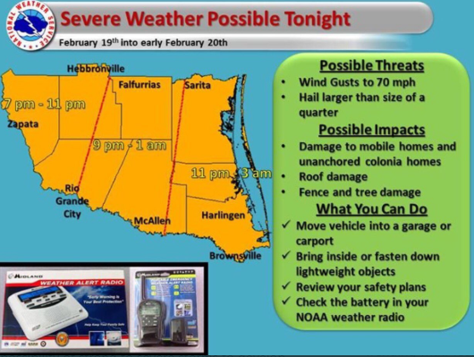
Sunday, Sept. 13th: 6pm
A severe weather system is moving through the Gulf of Mexico towards the Rio Grande Valley. Projected impact includes heavy rains starting at 6pm with a strong possibility of flash flooding throughout the area. Radar indicates that the storm is producing winds between 25-30 MPH. The National Weather Service in Brownsville has issued a flash flood watch for most of the Rio Grande Valley through 10am Monday.

Slide 14
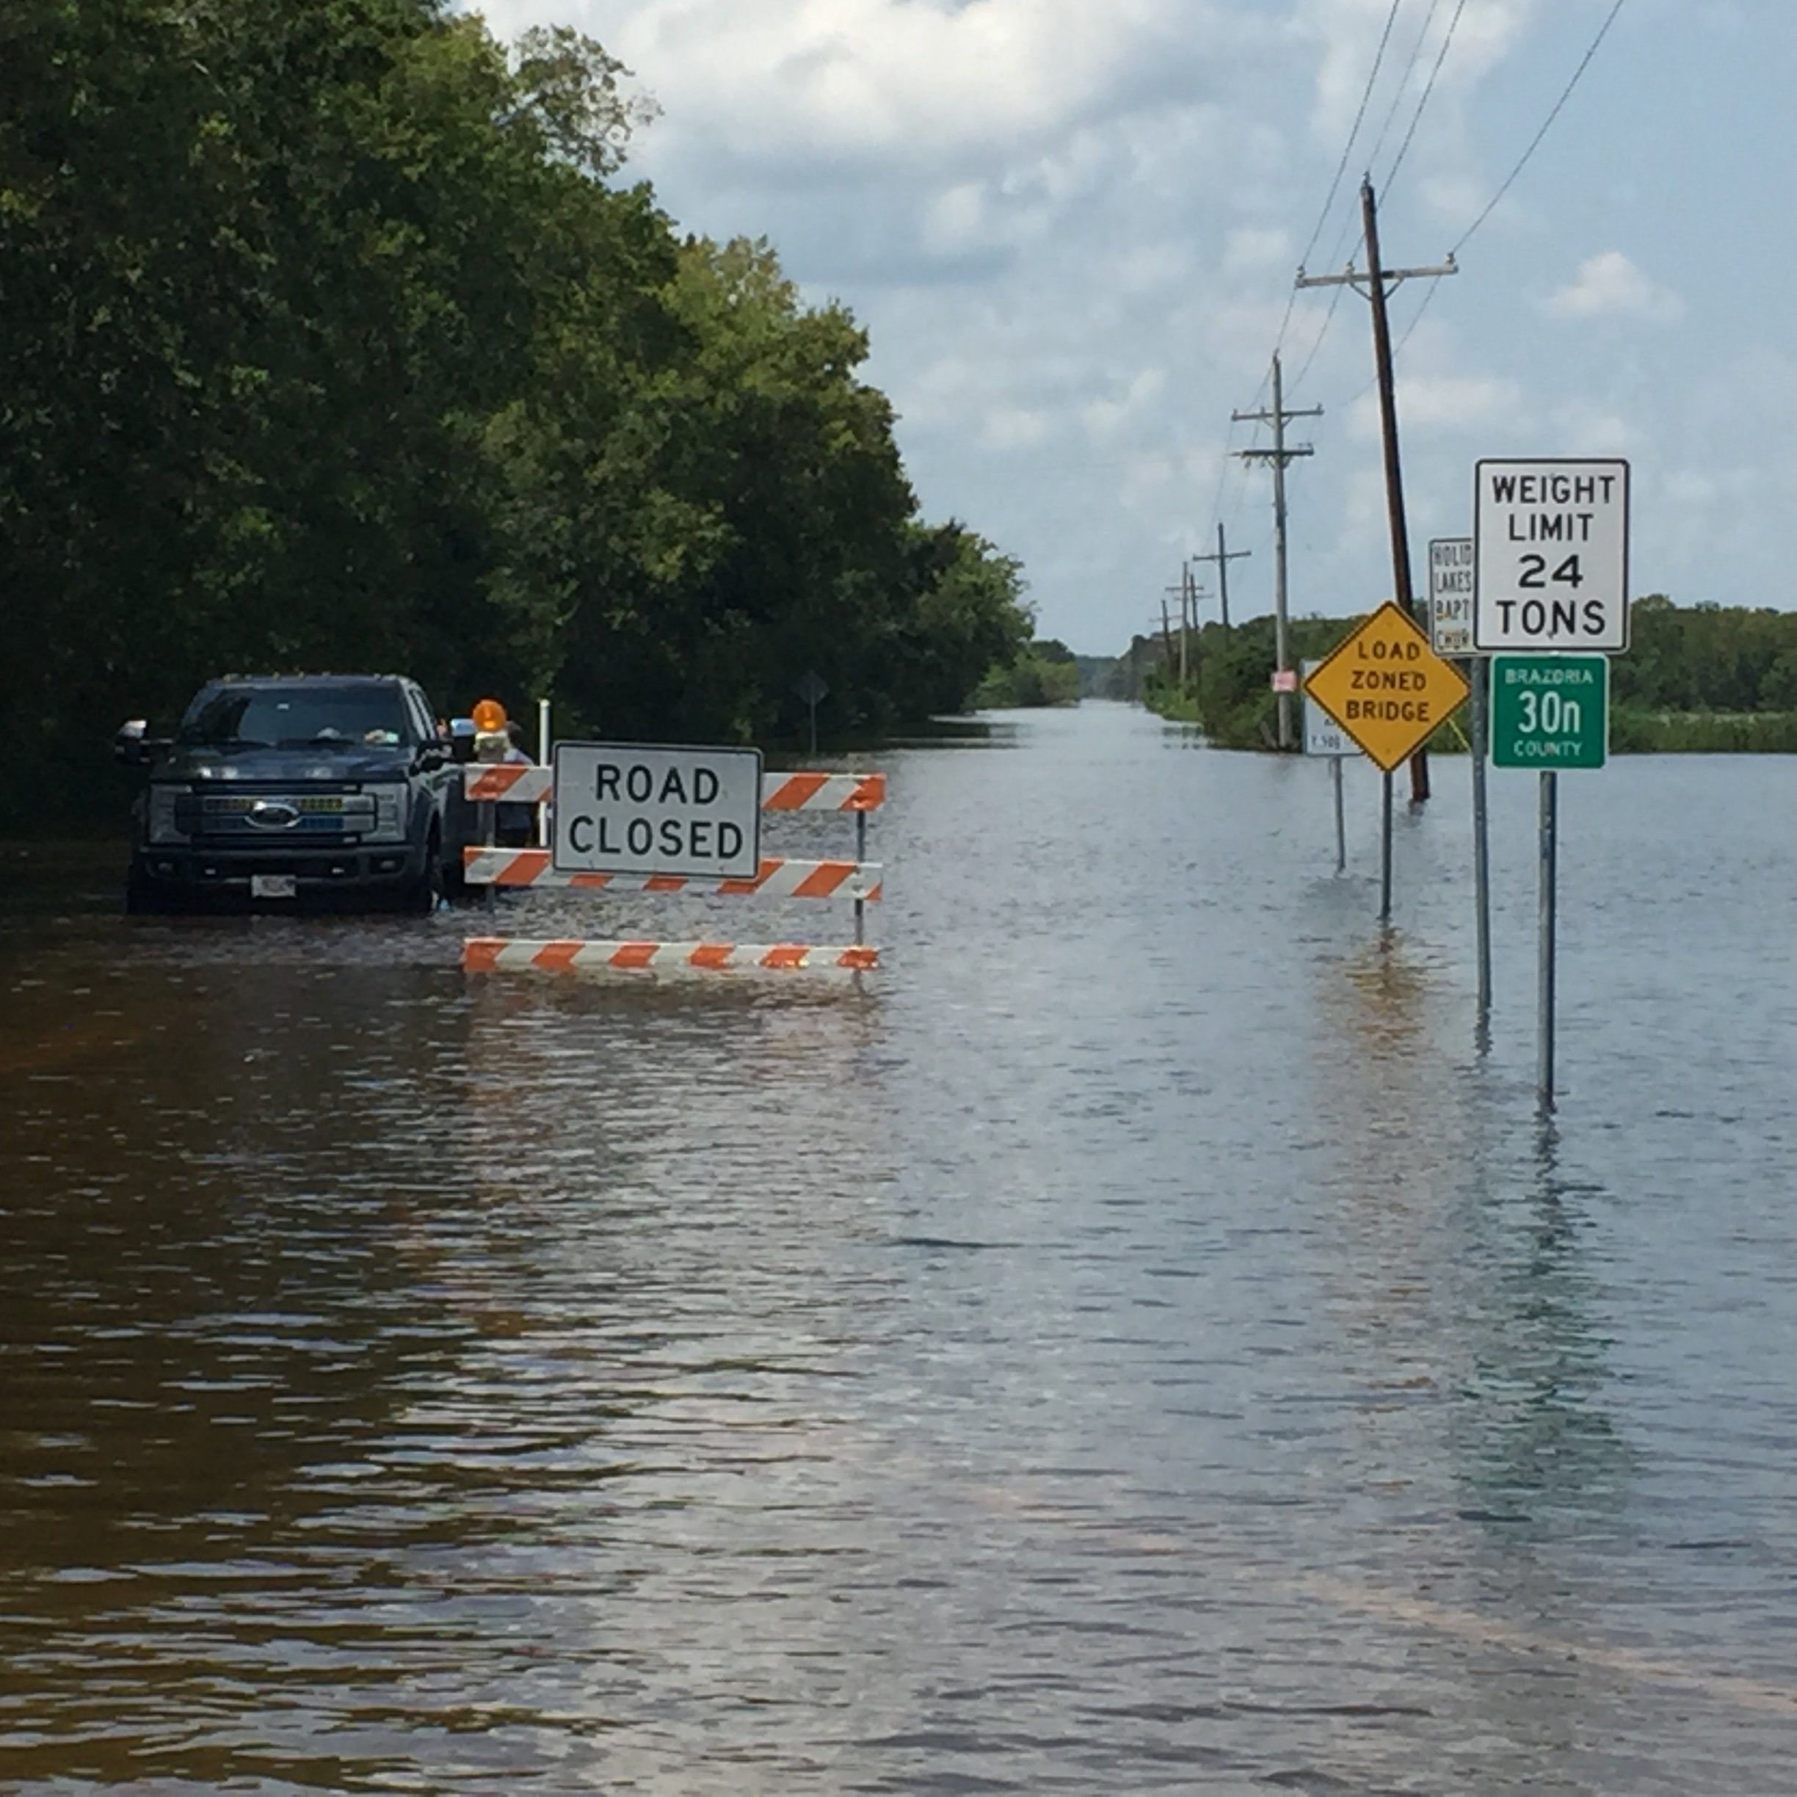
Monday, Sept. 14th: 6am
By 6am the following morning, the following roads leading to campus are impassible: Ware Road, Monte Cristo, Conway, N. Shary Road, and St. Hwy 107. Access to the campus is completely shut off.

Slide 15
Discussion Questions
What initial actions are being taken by the Emergency Management Team?
How is information being communicated to the campus community?
What are the top three concerns for this type of scenario?

Slide 16
Break
15 mins

Slide 17
Module 2
Rapid Onset Severe Weather

Slide 18
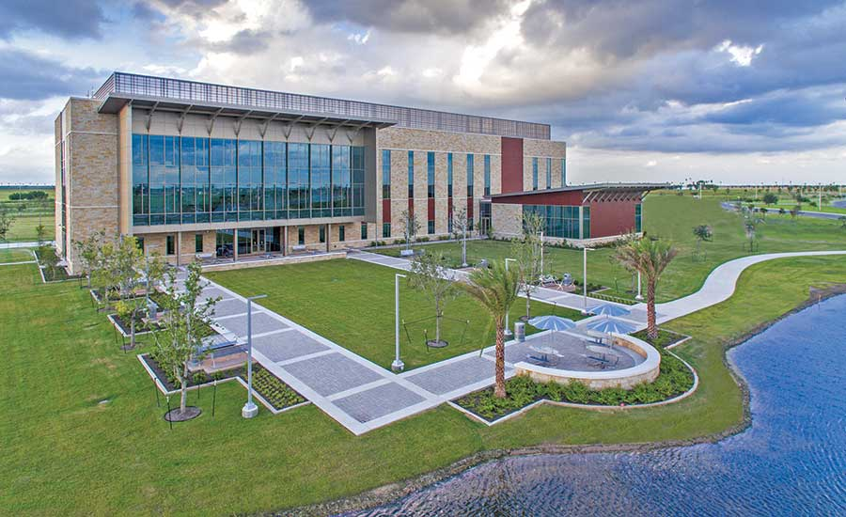
Tuesday, April 14th: 12:00pm
It is a typical Tuesday in the spring semester. While the forecast has indicated the potential for rain, nothing severe has been forecasted for the day. However, as the weather system develops through the morning, the rain and winds begin to intensify.

Slide 19
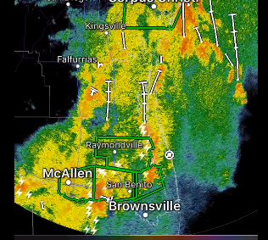
Tuesday, April 14th: 12:00pm
Around noon, a severe storm cell develops and pushes across the campus. Straight-line winds barrel down on the campus. Debris and exterior fixtures not bolted down outside go through several downstairs windows. There are multiple minor injuries throughout the building due to flying debris. Access to the campus is also affected due to flash flooding in the area.

Slide 20
Discussion Questions
What actions are being taken by the Emergency Management Team?
How is information being communicated to the campus community?
Are there any additional issues or considerations?

Slide 21
Module 3
Recovery

Slide 22
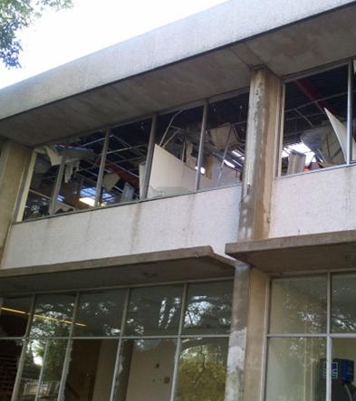
Wednesday, April 15th: 10am
By the following day, the flood waters have receded. Initial damage assessments show that there is significant water damage to 1st and 2nd floors due to the broken windows. There are also several leaks reported on the 3rd floor due to roof damage. Several student and staff vehicles in the parking lot were also damaged by flying debris. It may take at least three weeks or more to repair the damage.

Slide 23
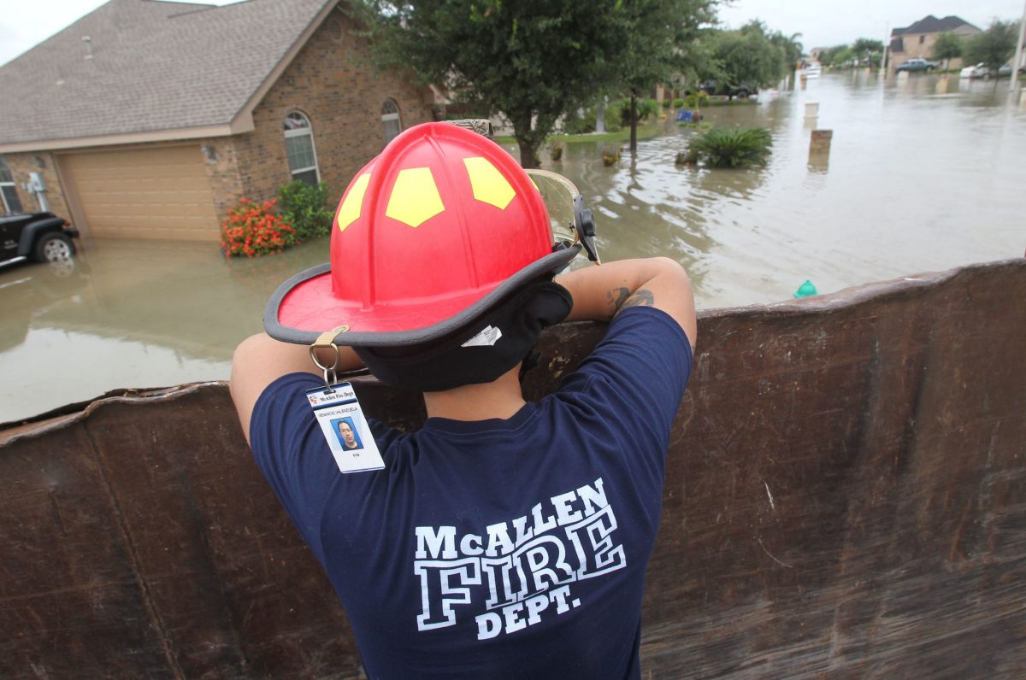
A staff check reveals that Dr. Neighbors’ home was devastated by the flooding and he is unable to return to teach his four courses. His return is unknown at this time. Marimar’s home also sustained flood damage and will be away from the office for extended periods of time.

Slide 24
Discussion Questions
What initial actions are being taken by the Emergency Management Team / Continuity Plan Activation Team?
What are the recovery priorities?
How will these recovery priorities be accomplished?
Are there any additional issues or considerations?

Slide 25
Hot Wash / Exercise Wrap-up

Slide 26
Exercise Wrap-up Discussion
Strengths
-
-
-
Areas for Improvements
-
-
-

Slide 27
Closing Comments
Thank you for participating.
Email additional thoughts or comments about the exercise.
An exercise summary and after action report will be shared with participants within 45 days.

Slide 28

Your Name
Your Title
Your Department/Division
Phone: XXX-XXX-XXXX
Email: email@tamu.edu

